Slide 1
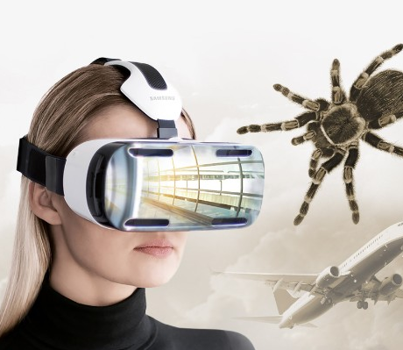
Ethics in Virtual and Augmented Reality
CT5142 AI and Ethics

Slide 2
Content
Experience of self and others in VR
Harm in VR
Ethical issues for VR in health and gaming
Augmented Reality
Deepfakes

Slide 3
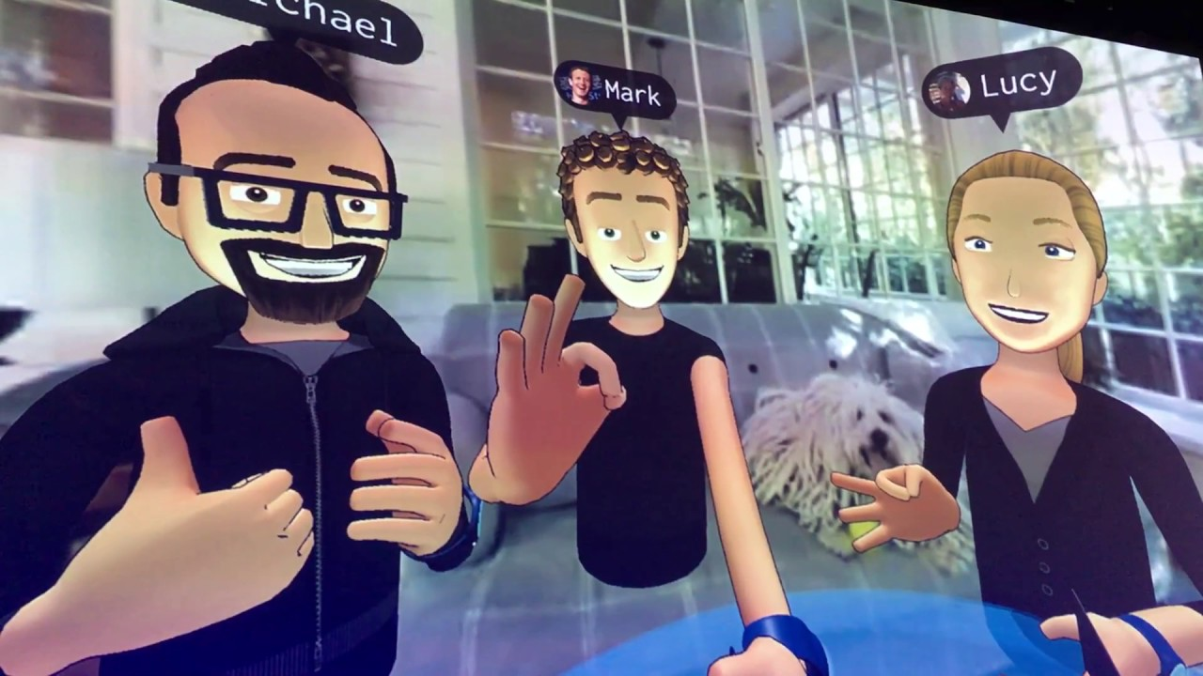
Experience of self and others in VR

Slide 4

Virtual and augmented reality
Virtual reality: immersive experience of a virtual world
Augmented reality: virtual features superimposed on normal physical environment
Continuum: real world - augmented reality – virtual reality

Slide 5
General characteristics of virtual reality experiences
New possibilities of widespread individual VR uses with head mounted displays, from gaming to therapy
Illusory nature of experience, feeling of reality
Possibility of new type of immersive experiences of self, embodiment and emotions
New types of social interaction in virtual spaces

Slide 6
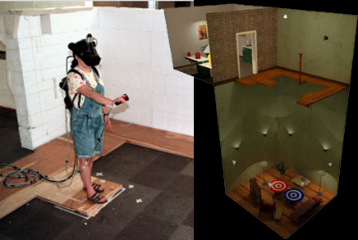
Experience of embodied self
Presence of self in virtual space linked to place illusion (sensation of being in a real place) and – less well established - internal or external plausibility/realism (credibility of the scenario)
VR representation linked to VR action impacts on how I experience my body – e.g. child vs. adult, third arm/hand
Experience of virtual dangers as real despite knowing better, e.g. “virtual pit”
Felt identification with a virtual body supported by sensory feedback

Slide 7

The Proteus effect
Proteus: Greek God of the sea, famous for ability to shape-shift
“Proteus effect” as conformity to individual identity clues in VR (Yee & Bailenson 2007)
avatar image impacts behaviour (e.g. tall = more confident, aggressive; attractive = less distance, more friendly)
Effects can carry over into real life
Yee & Bailenson 2009 re assertiveness and tall avatars
Fox, Bailenson & Tricase 2013 re self-objectification and sexualised game avatars

Slide 8
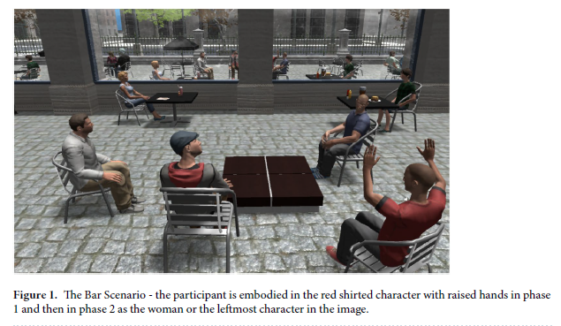
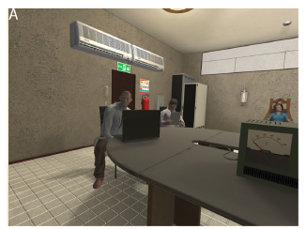
VR and empathy / identification
Gender and harassment (Neyret et al. 2020): (1) males with female avatar harrassed in VR by group of men, (2) lower willingness than controls to administer electro shocks to female avatar in VR Milgram experiment where experimenters used sexist comments
Rueda & Lara (2020)

Slide 9
How real does it feel to be in virtual reality?
Sense of reality of VR dependent on various factors:
Granularity of input and output
Ability to modify virtual environment
Possibility of social interaction in virtual world
Extent of mutually interactive agents in the virtual world

Slide 10

Harms in VR

Slide 11
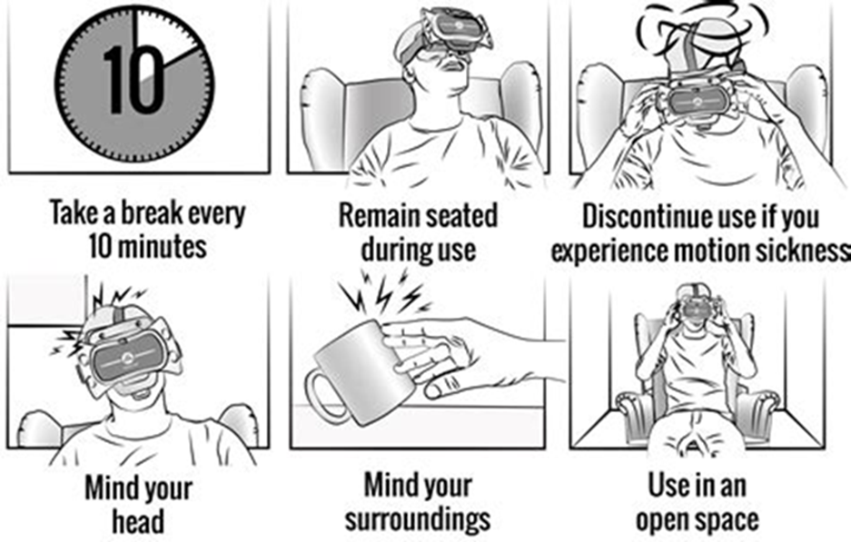
Health related concerns
Safety (e.g. tripping, falling, breaking objects in environment)
Motion sickness, „cybersickness“
Fatigue
Emotional effects heightened by immersive experience, e.g. aggression, upset, depression (e.g. Lavoie et al. 2020, 36% participants reported past intense negative experience; also experimental shame induction)
Addiction to gaming experience

Slide 12
Potential for „deep“ manipulation
Modifiability of virtual worlds
Dependence of experience on decisions by designers
Impact of modifications in VR can be directly evaluated and tailored towards desired outcomes
Impact potentially on how self and its embodiment is experienced

Slide 13
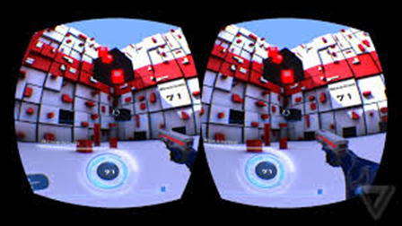
Harms for self in VR
Potential addictiveness of long-term VR immersion
Difficulties of switching between virtual and real bodies
Potential impact on experience of „realness“ of the world (derealisation, shifting realness to VR)

Slide 14
Privacy and new data capture
Physiological and behavioural parameters in relationship to engagement with VR world
„kinematic fingerprint“: potentially unique identifiable movement patterns, e.g. usable for authentication
Privacy implications of integration of social media and VR (O‘Brolchain 2016, FB login for Oculus 2020)
VR based behavioural manipulation through hidden data integration from multiple sources

Slide 15

Ethical issues of VR in health

Slide 16
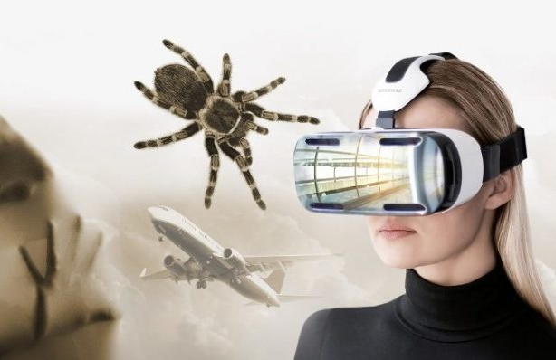

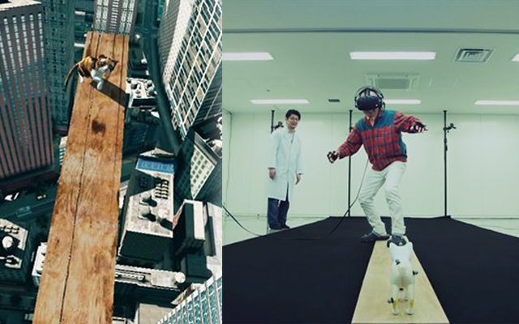
VR therapy
Promising results of VR therapy for anxiety: various phobias, agoraphobia, posttraumatic stress disorder
Wide range of currently researched applications:
attention training for ADHD
social skills training for autism

Slide 17
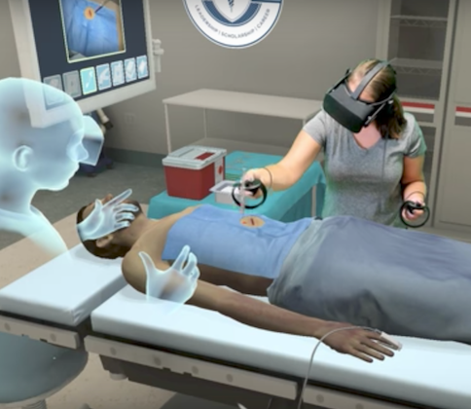
VR training
VR for novel training opportunities for professionals who need to acquire complex skills without risk
Oldest example: flight simulator
Medical: human anatomy, surgical training, paramedic and emergency room training, dentistry

Slide 18
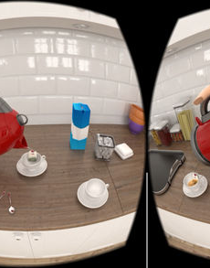
Understanding health conditions
Seeing the world through someone else‘s eyes
for medical, nursing and social care staff to get a sense of experience of clients
But also for motivating patients in preventative medicine
Examples: vision loss, hearing loss, vertigo, dementia, negative effects of smoking, autism, psychosis

Slide 19
Some ethical considerations in designing VR applications in health
real world validity of practiced skills
diverse stakeholder involvement
stereotyping and stigmatisation
user safety
respect
user autonomy
accessibility
diversity

Slide 20
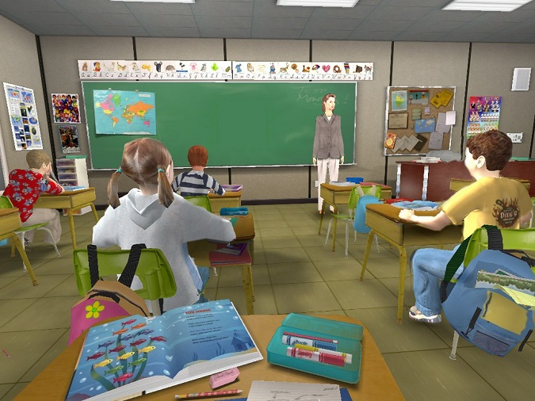
Examples of ethical design challenges
Scenario 1: Design of a gamified VR system for social skills training for autism, with close monitoring of gaze direction and virtual reward and punishment for socially appropriate responses in scripted social situations
Scenario 2: Design of VR system for training doctors in emergency room triage, with virtual patients with a variety of health and psychiatric conditions and disruptive patients

Slide 21
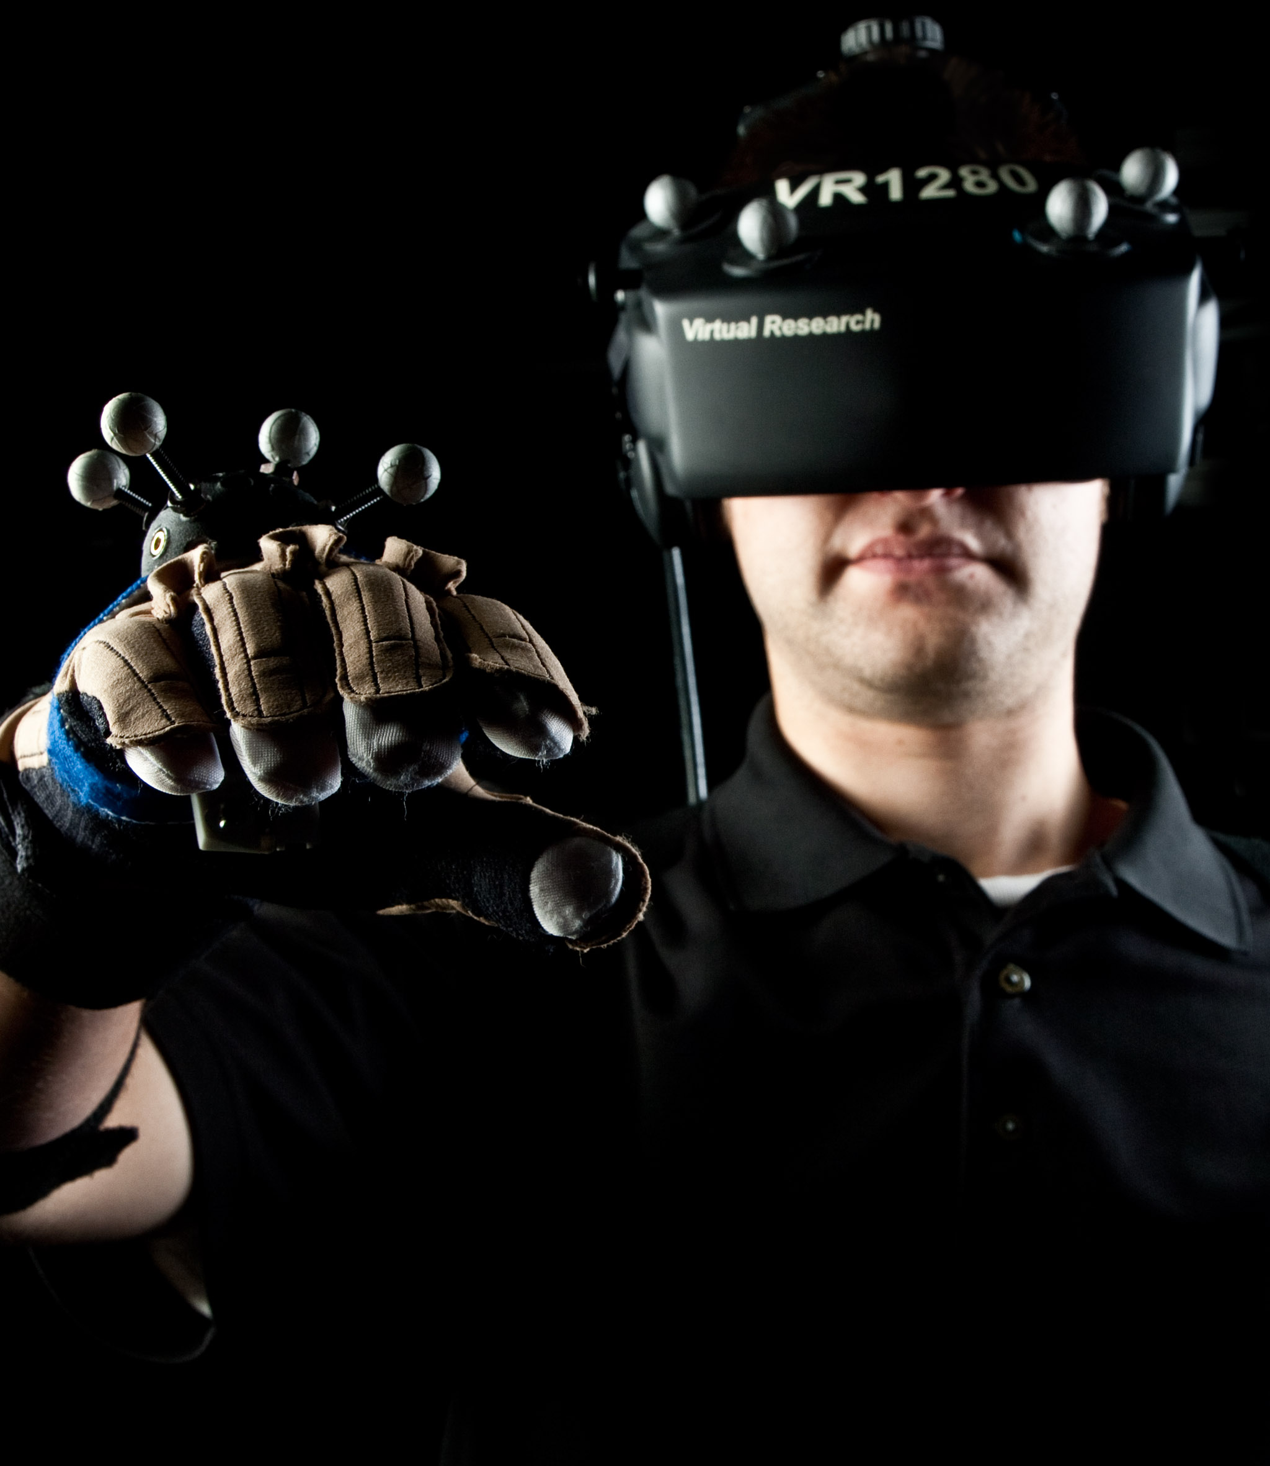
Ethical issues in VR Gaming

Slide 22
Social impact of VR gaming
Risk of withdrawal from real world in favour of VR (similar to withdrawal into online communication)
Replacement of ordinary interactions
Reduction of sensory complexity or overall quality of experience in VR telepresence
Enhancement of ordinary experience?

Slide 23
Does antisocial virtual behaviour matter ethically?
Antisocial behaviour as common phenomenon online and in VR
Virtual theft, virtual violence, virtual rape, virtual pedophilia
“if avatars find it amusing to make the lives of others miserable, they will find ways to do so” (Hunter and Lastowka 2003)
Why does harm to avatars, i.e. fictional online selves, matter?

Slide 24
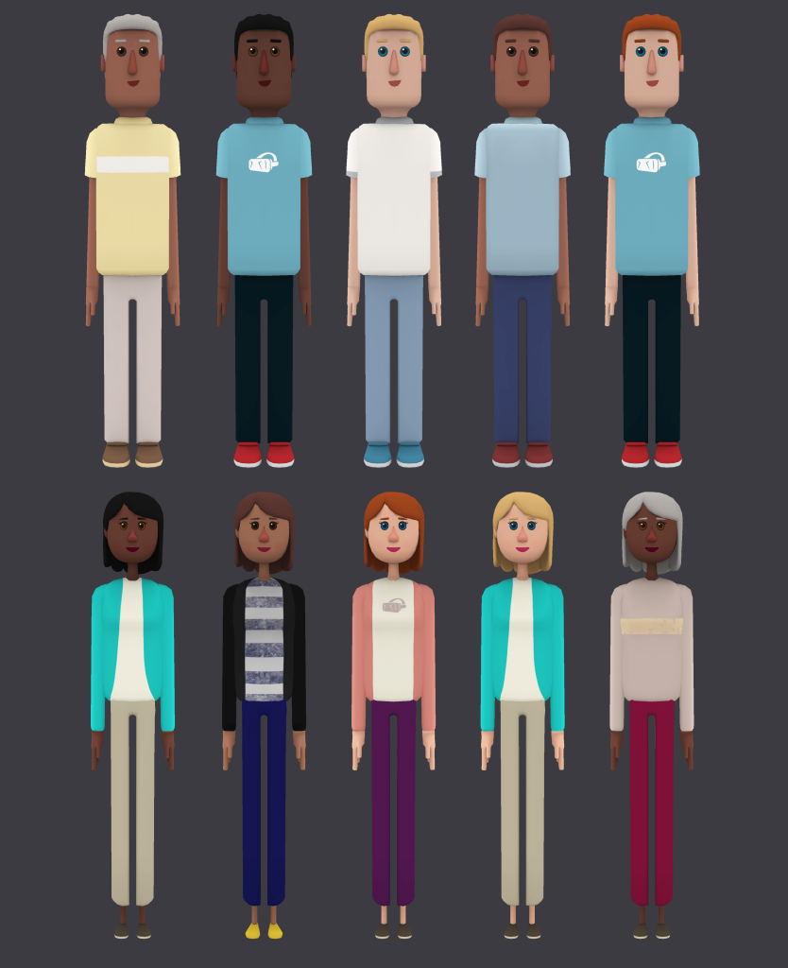
Understanding the relationship between self and avatar (Wolfendale 2008)
Avatar created and used with certain intentions and expectation
Emotional attachment to avatars as significantly similar to attachment within real life
Avatar attachments are expressive of identity and self-conception and should be morally respected (“controller-character identification”)
Virtual engagement with virtual characters is mostly reciprocal and affects others and oneself

Slide 25
Does virtual harm in games matter? (Wolfendale 2008)
Experience of virtual harm as common and emotionally intense, morally inappropriate to disregard its effects
Interaction between online characters may follow different rules from real life, but uses building blocks from real life
Engagement with other avatars takes place in a social space that follows certain implicit or explicit rules, thereby effectively implementing specific moral norms and boundaries
Violations of these expectations as harmful

Slide 26
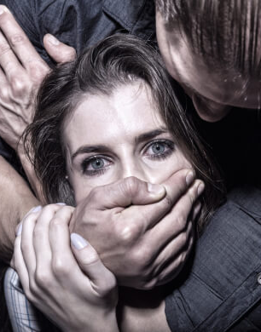
Virtual sexual assault (Danaher 2018)
Virtual sexual assault: an unwanted, forced or non-consensual sexually explicit behaviour performed by virtual characters, to one another, acting through representations in a virtual environment
Example: „Jordan Belamire was playing the game [QuiVR] in her home. While playing another user … started to rub the area near where her breasts would be … She screamed at him to stop but he proceeded to chase her around the virtual environment and then to rub her virtual crotch.“
Given the immersive experience of embodiment in VR, how should virtual sexual assault be dealt with?

Slide 27

Ethical issues in Augmented Reality

Slide 28
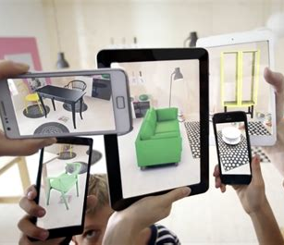
Augmented reality
virtual features are added to the real world environment by means of a device, e.g. Google Glass, smartphone
Uses for entertainment, tourism, consumer information, advertising, data visualisation and design presentation
Varying degrees of immediacy, i.e. requiring separate action, automatic pop-up, overlaid over ordinary perception with visual immediacy
Continuous super-imposition onto reality through wearable devices, e.g. AR goggles, or other devices that continuously mediate our access to reality may affect how reality is perceived

Slide 29
Super-realism and the device-gap
VR necessarily characterised by „device gap“, i.e. non-continuous interaction due to nature of device needed for access to VR; AR closing that gap
Accompanies user through a modified world with possibility of ongoing additional information feed, altering experience of real world; persuasiveness
creating “a paradox of visually validated truth comprised by the simultaneous appearance of real truth and possible (virtual) truth, possibly further challenging the separation of real and virtual worlds” (Slater et al. 2020, p.4)
Conceived of as enrichment, but also could also potentially be tendentious/biased/deceptive – also risk of false memory
Ensuring that virtual elements are always clearly identified as such (specific agreed conventions needed)

Slide 30
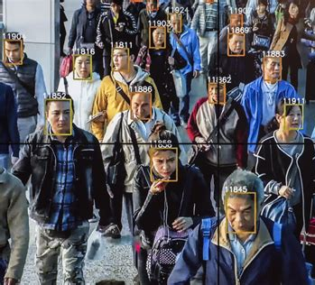
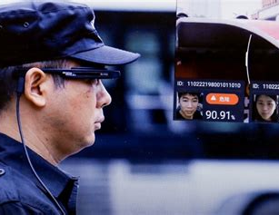
Privacy and AR
Superimposition of personal information onto social reality, e.g. through combining face recognition and social media and other online information
Private or government use
Perceived generally as „creepy“, problematic surveillance and significant privacy intrusion
Appears more accepted with beacon-based advertising in commercial settings

Slide 31
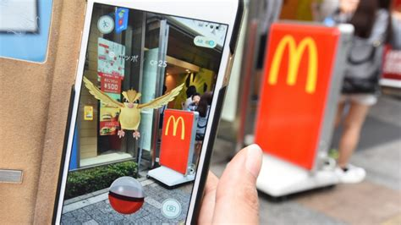
Property rights and AR (Neely 2019)
Imposing additional information layer onto reality may intrude into persons‘ property
Pokemon Go frequently adding Pokemons onto private property, not always with owners‘ agreement
„digital graffiti“, „work of art“, „product of labour“, or „free speech“?
Must augmentation receive permission by owner? Malicious augmentations (virtual slurs, private information, reputation damaging)
Risk of privatisation of perception of public spaces (device dependent or application dependent)

Slide 32

The harms of deepfakes

Slide 33
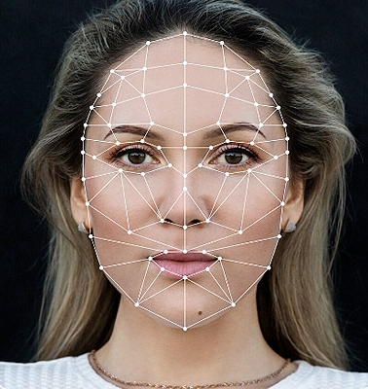
What is a deepfake?
Deepfake vs “cheap fake” or “shallow fake” – AI vs. more simple editing
Deepfake: using machine learning technology “to produce realistic looking and sounding video or audio files of people doing or saying things they did not do”, using AI (de Ruiter, 2021)
person A (the “source”) controls the facial expressions of person B (the “target”) in a recording, in the sense that realistic looking video images are produced of person B “mimicking” the expressions actually made by person A
Increasingly subtle signs of manipulation
Could potentially used for good: disguising witnesses, regenerating voice for persons who have lost voice through illness, allow for gender-specific social presence for trans people, bringing historical figures to life for educational purposes, creatively employ technology for artistic purposes

Slide 34
Some examples
Nancy Pelosi’s depiction of slurred speech in 2019 (not an AI deepfake, just fairly simple editing)
Youtube: many (harmless?) deepfake videos of movie actors in unexpected roles
Celebrity Porn, e.g. faces of famous actresses inserted into pornographic materials – face-swapping apps
Estimate: 96% of deepfakes in 2019 were pornographic
330% increase in number of deepfake videos online between July 2019-June 2020
Fears: manipulate emotionally salient micro-expressions, stoking conflict, decreasing trust in reliability and evidentiary value of real footage

Slide 35
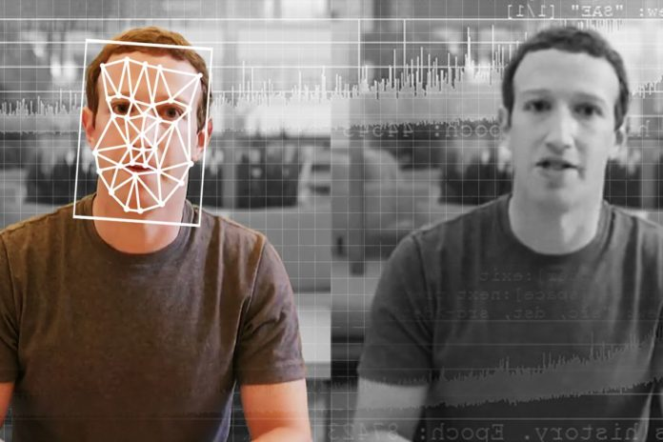
Criteria for morally problematic deepfakes (de Ruiter 2021)
Three factors for morally problematic use of deepfake:
(i) whether the deepfaked person(s) would object to the way in which they are represented
(ii) whether the deepfake deceives viewers
(iii) the intent with which the deepfake was created

Slide 36

Specific concerns
Reputational injury (Franks & Waldman 2019) and effects on social identity: e.g. pornographic depictions turning individuals into objects of sexual entertainment
“digital impersonation” (Citron & Chesney 2019) or “Persona plagiarism” (Diakopoulos and Johnson 2020): “an inversion of plagiarism focused on the source rather than the content of a message”
Core: “use digital data that represent a person’s image or voice to attribute particular actions and speech to them”, given additional weight through embodiment, “horribly believable” (de Ruiter 2021) – Kant’s respect for persons as ends in themselves
Defamation and privacy concerns (Kugler 2021)

